Slide 1
EMBEDDED SYSTEMS / SECURITY AUTOMATION
SMART LOCKER
SECURITY SYSTEM
Two-Factor Dynamic OTP + Silent Duress Alarm
An Arduino-based electronic locker concept combining password verification, time-limited OTP, monitoring, and emergency alerting.
2-FACTOR
AUTHENTICATION
TEAM MEMBERS
ASK NAYANIDA – CB.SC.U4CSE25601
ADWAITH V – CB.SC.U4CSE25602
AGASTYA JL – CB.SC.U4CSE25603
SHANJANA V – CB.SC.U4CSE25654

Slide 2
Problem Statement & Motivation
01 / WHY THIS PROJECT
KEY / LOCK RISKS
COERCION DILEMMA
LEFT-OPEN RISK
Mechanical keys can be copied, stolen, or picked.
Static PINs can be observed or inferred.
A person threatened into opening a safe may have no discreet way to request help.
Users may forget to secure a locker after accessing its contents.
Design motivation
Bring multi-factor authentication and event monitoring to physical storage—while keeping the user workflow simple and providing a discreet duress signal.
SMART LOCKER SECURITY SYSTEM • PROJECT PRESENTATION
02

Slide 3
Proposed System & Objectives
02 / THE SOLUTION
FACTOR 1
FACTOR 2
DURESS MODE
Master password entered through a 4×4 keypad.
Random 4-digit OTP with a 60-second validity window.
Special 9999# code follows the normal unlock flow while generating a silent alert.
• Allow the locker to remain open while the user is accessing items.
• Warn if the door is left open for more than two minutes.
• Apply a three-failure limit and a 30-second lockout.
• Monitor door contact and nearby motion where sensors are installed.
SMART LOCKER SECURITY SYSTEM • PROJECT PRESENTATION
03

Slide 4
System Architecture
03 / INPUT → CONTROL → OUTPUT
INPUTS
CONTROLLER
OUTPUTS
4×4 keypad
Door / reed switch
PIR motion sensor
Analog seed input
Arduino Uno
Authentication logic
OTP timer + attempt counter
EEPROM credential storage
16×2 I²C LCD
SG90 servo latch
Buzzer + status LEDs
Serial / GSM alert
The Arduino coordinates user input, authentication state, timers, sensors and alerts.
SMART LOCKER SECURITY SYSTEM • PROJECT PRESENTATION
04

Slide 5
Working Principle & Operational Flow
05 / AUTHENTICATION SEQUENCE
01 Boot
02 Password
03 OTP
Initialize hardware, LCD and EEPROM.
User enters master password.
Generate and deliver a 4-digit OTP; start 60 s timer.
04 Verify
05 Unlock
06 Secure
Check code and expiry; count failed attempts.
Move servo to 90°; green LED; start open timer.
User presses # to lock; alert if open > 2 min.
Special cases: C resends OTP • * clears input • 3 failed attempts trigger 30-second lockout.
SMART LOCKER SECURITY SYSTEM • PROJECT PRESENTATION
06

Slide 6
Core Security Features
06 / WHAT MAKES IT DIFFERENT
DYNAMIC OTP
SILENT DURESS CODE
Four-digit code; 60-second expiry; user can request a fresh code with C.
9999# opens through the usual flow and triggers a discreet high-priority alert.
LEFT-OPEN GUARDIAN
BRUTE-FORCE LIMIT
If the locker remains open beyond two minutes, buzzer and warning alert activate.
Three failed attempts lead to a 30-second lockout and admin alert.
SMART LOCKER SECURITY SYSTEM • PROJECT PRESENTATION
07

Slide 7
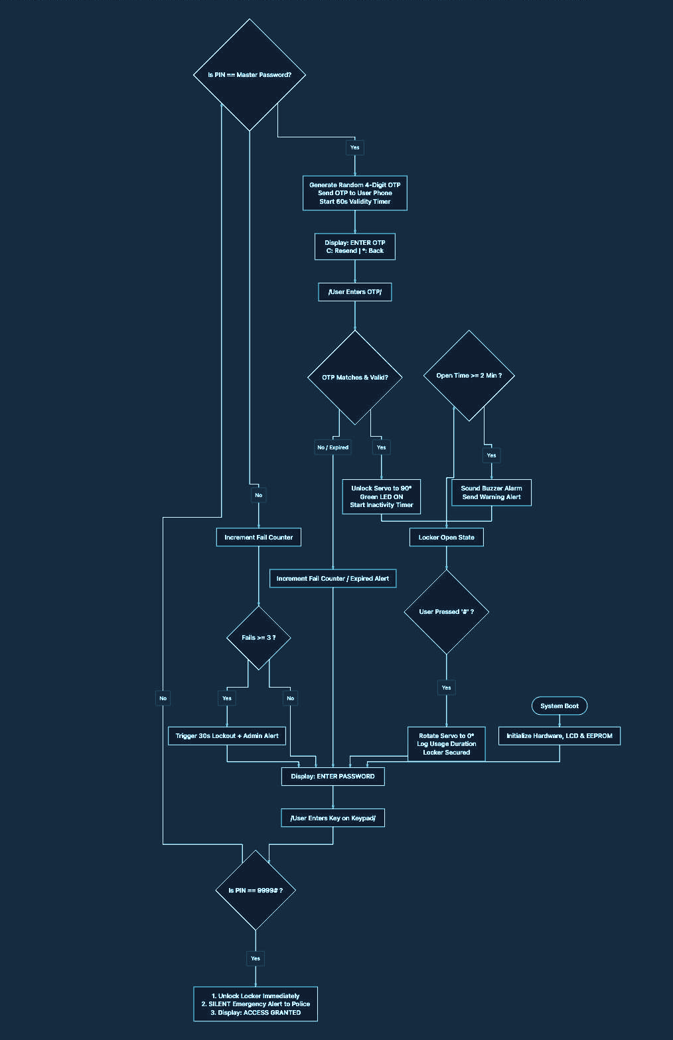
Complete Security Flowchart
07 / VISUAL LOGIC
SMART LOCKER SECURITY SYSTEM • PROJECT PRESENTATION
08

Slide 8
Hardware Components & Roles
04 / BILL OF MATERIALS
Arduino Uno / ATmega328P
Main controller • 16 MHz • 2 KB SRAM
4×4 membrane keypad
PIN, OTP and admin input • D2–D9
1602 LCD + PCF8574 I²C
User prompts/status • A4 SDA, A5 SCL
SG90 micro servo
Latch actuator • D10 PWM
Piezo buzzer + LEDs
Audio/visual feedback • D11–D13, A0
Door switch + PIR
Door/tamper and motion monitoring • A1, A2
EEPROM + optional SIM800L
Credential persistence; SMS in physical build
SMART LOCKER SECURITY SYSTEM • PROJECT PRESENTATION
05

Slide 9
Circuit Design & Pin Mapping
08 / WIRING SUMMARY
ARDUINO UNO — PIN ASSIGNMENTS
D2–D9
4×4 KEYPAD — ROWS & COLUMNS
A1
DOOR SENSOR (INPUT_PULLUP)
D10
SERVO PWM SIGNAL
A2
PIR MOTION SENSOR
D11
BUZZER
A3
ANALOG INPUT FOR RANDOM SEED
D12 / D13
RED / GREEN STATUS LEDS
A4 / A5
LCD I²C — SDA / SCL
A0
YELLOW STATUS LED
D0 / D1
UART FOR SERIAL / GSM (OPTIONAL)
I²C LCD reduces display wiring to two signal lines: SDA and SCL.
SMART LOCKER SECURITY SYSTEM • PROJECT PRESENTATION
09

Slide 10
Software Architecture & Memory Optimization
09 / EMBEDDED C++
STATE LOGIC
FLASH STRINGS
EEPROM
Boot → password → OTP → unlock → open monitoring → lock.
Use F() / PROGMEM for fixed UI and serial strings to reduce SRAM use.
Store credentials persistently with a validation marker (0xAA).
Reported optimization in the supplied project notes
Static string RAM use: 1,502 bytes → 65 bytes (about 95% reduction). This is the reported project figure; confirm with the final compiled build.
SMART LOCKER SECURITY SYSTEM • PROJECT PRESENTATION
10

Slide 11
Simulation & Experimental Results
10 / WOKWI TEST FLOW
TEST 1 • VALID ACCESS
TEST 2 • EXPIRY / FAIL
TEST 3 • DURESS / OPEN
Enter 1234#
OTP generated: example 4729
Enter 4729#
Expected: ACCESS_GRANTED
Wait beyond 60 seconds or enter a wrong OTP.
Expected: reject OTP, count failure and show status.
Enter 9999# for duress alert.
Leave door open > 2 minutes to test warning.
Press # to secure.
The supplied notes show Serial Monitor output for OTP, access-granted alert, and successful relocking.
SMART LOCKER SECURITY SYSTEM • PROJECT PRESENTATION
11

Slide 12
Advantages & Real-World Applications
12 / WHERE IT CAN HELP
ADVANTAGES
APPLICATIONS
• Two-factor access
• Time-limited OTP
• Discreet duress alert concept
• Left-open warning
• Low-cost embedded platform
• Can operate without cloud dependency when using local logic / cellular SMS
• Bank and safe-deposit lockers
• Jewellery and retail storage
• Gym and campus lockers
• Pharmacy storage cabinets
• Parcel collection lockers
• Personal document or equipment safes
SMART LOCKER SECURITY SYSTEM • PROJECT PRESENTATION
13

Slide 13
Physical Prototype & Real-World Integration
11 / FROM SIMULATION TO HARDWARE
SIMULATION
CELLULAR SMS
Serial Monitor can emulate delivery of an OTP and show telemetry during testing.
SIM800L can send SMS using AT commands such as AT+CMGF=1 and AT+CMGS.
POWER DESIGN
MECHANICAL LATCH
Use regulated supplies appropriate to the Arduino, servo and GSM current peaks.
Couple the servo to a suitable sliding deadbolt; test alignment and torque.
Prototype status and SMS delivery should be verified on the actual hardware before claiming deployment.
SMART LOCKER SECURITY SYSTEM • PROJECT PRESENTATION
12

Slide 14
Future Scope & Enhancements
13 / NEXT ITERATION
3-FACTOR ACCESS
BIOMETRICS
CLOUD / APP
Add MFRC522 RFID card verification alongside password and OTP.
Integrate an optical fingerprint sensor such as R307.
ESP32 + Wi-Fi/MQTT, Firebase logging and mobile push notifications.
AUDIT TIMESTAMPS
Add DS3231 RTC for battery-backed event timestamps and audit logs.
SMART LOCKER SECURITY SYSTEM • PROJECT PRESENTATION
14

Slide 15
Conclusion & Key Takeaways
14 / PROJECT SUMMARY
A layered approach to physical locker security.
• Combines a master password with a time-limited OTP.
• Introduces a discreet duress-code alert for coercion scenarios.
• Monitors door-open duration and limits repeated failed attempts.
• Uses embedded C++ techniques and EEPROM for constrained hardware.
• Provides a practical foundation for a physical prototype and future upgrades.
Key message: secure access should protect both stored valuables and the person using the locker.
SMART LOCKER SECURITY SYSTEM • PROJECT PRESENTATION
15

